Slide 1

Allstate Claim Prediction Challenge
IronHack final project

Slide 2
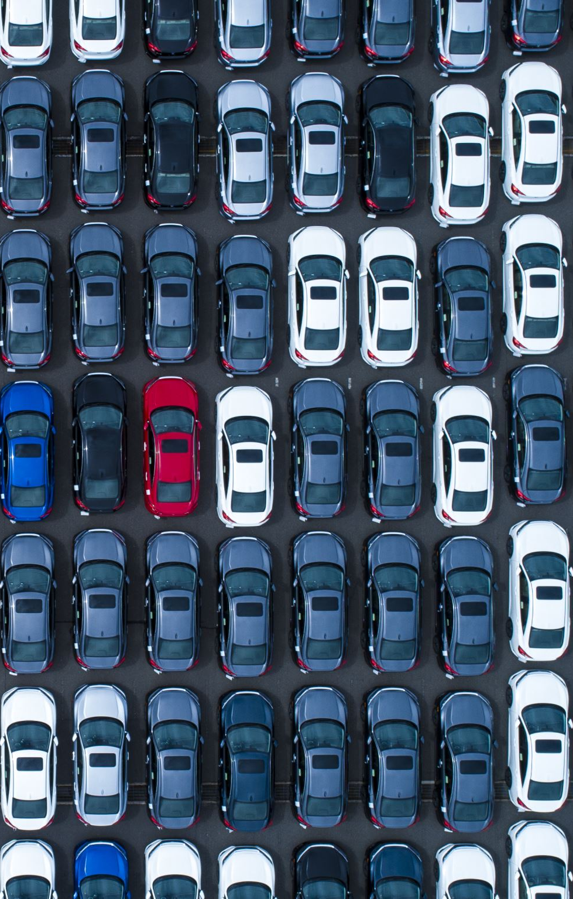
Goal
The goal of this competition is to predict Bodily Injury Liability Insurance claim payments based on the characteristics of the insured’s vehicle

Slide 3
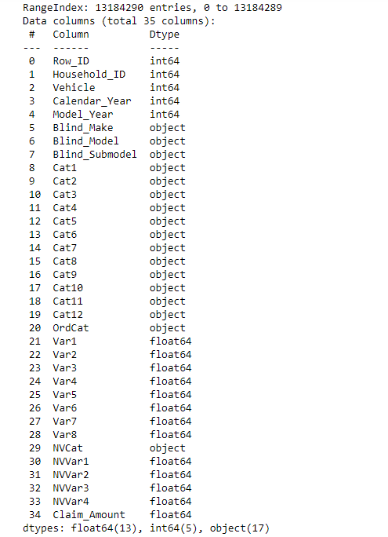
Data

Slide 4
Preparing the data
New Variables:
years_insurance → 2007 – calendar_year
age_car → 2007 – model year
Claimed → If the insurance was user or not (0 or 1)
Sample
Dataset too big

Slide 5
Classifying the data
Categorical Variables:
['Blind_Make', 'Blind_Model', 'Blind_Submodel', 'Cat1', 'Cat2', 'Cat3','Cat4', 'Cat5', 'Cat6', 'Cat7', 'Cat8', 'Cat9', 'Cat10', 'Cat11', 'Cat12','OrdCat_cat','NVCat’]
Numerical Variables
['Var1', 'Var2', 'Var3', 'Var4', 'Var5', 'Var6','Var7', 'Var8','NVVar1', 'NVVar2', 'NVVar3', 'NVVar4','years_insurance', 'age_car’]
Dependent Variables
‘Claimed’
‘Claim_Amount’

Slide 6
First Model: Claim probability
Preparation Pipeline
Categorical:
OnehotEnconder
Umap
Numerical:
Standard Scaler
Prediction model: Logistic Regression

Slide 7
Second Model: Claim Value
Data: claimed = 1
Preparation Pipeline
Categorical:
OnehotEnconder
Umap
Numerical:
Standard Scaler
Prediction model: Linear Regression

Slide 8
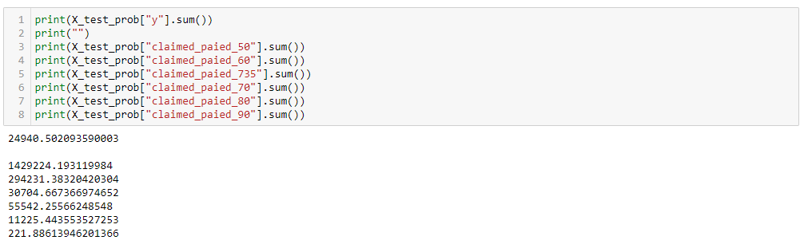
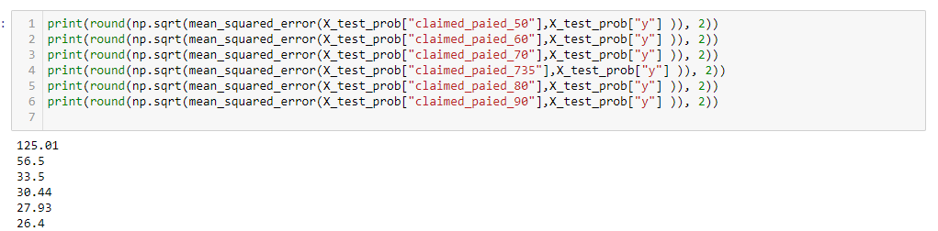
Final Prediction
Claim_Amount = Claim probability X Claim value
Probability threshold:
73,5%

Slide 9
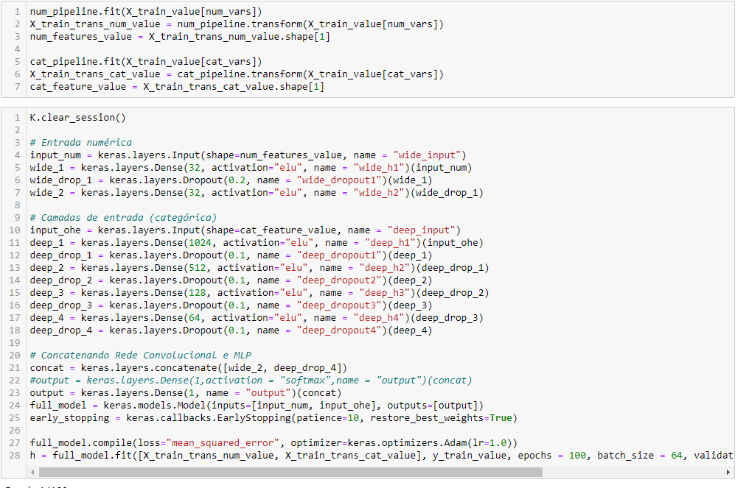
Problems faced
Huge Dataset
Install TensorFlow
Machine Learning didn’t work properly

Slide 10
Next Steps
Model optmization
Selection of better parameters
Try new techniques

